Slide 1


Session_11
By Eng-Adham Khaled

Slide 2


Slide 3

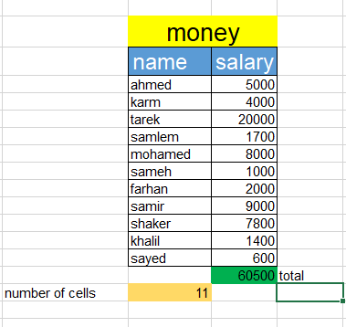
Task on equation SUM and counta
SYNTAX: =sum + tab write equal and word sum and push tab
SYNTAX: =counta + tab write equal and word counta and push tab

Slide 4
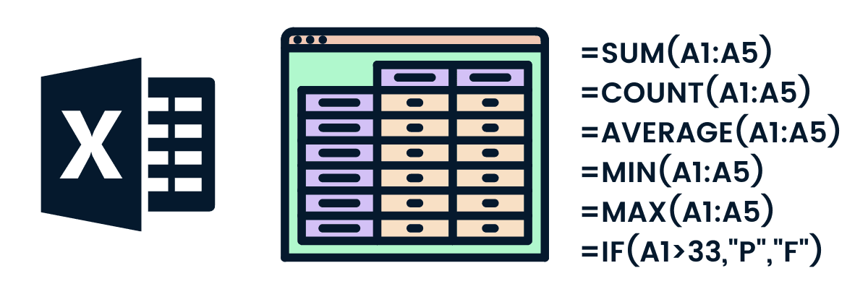

Try the next functions

Slide 5
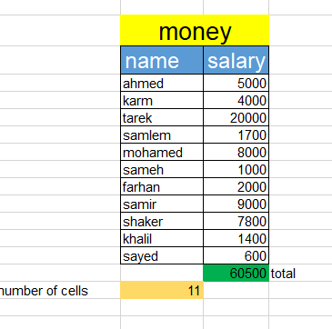
Insert new column or row in table
Add new column here
Add new row here

Slide 6
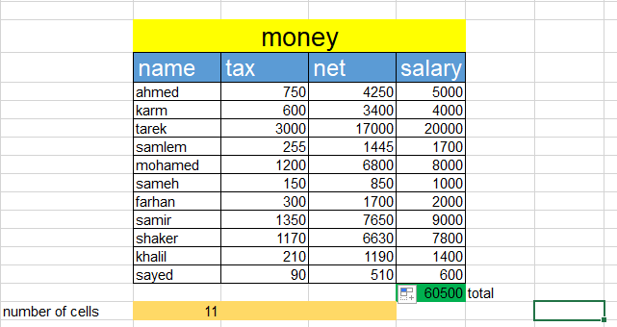
Task2 equation

Slide 7
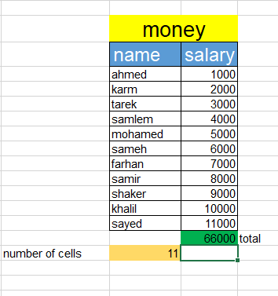

Homework
Do the same in session:
Add tax column
Add net column

Slide 8


